Slide 1
VIEW OF DATA

Slide 2
A database system is a collection of interrelated data and a set of programs that allow users to access and modify these data.
A major purpose of a database system is to provide users with an abstract view of the data.
The system hides certain details of how the data are stored and maintained.

Slide 3
1.3.1 Data Models
1.3.2 Relational Data Model
1.3.3 Data Abstraction

Slide 4
  1.3.1 Data Models
  -underlying the structure of a database .
  -collection of conceptual tools for describing data, data relationships, data semantics, and consistency constraints.
  -It’s classified into four different categories:
    Relational Model.
    Entity-Relationship Model.
    Semi-structured Data Model
    Object-Based Data Model.

Slide 5
i.Relational Model.
It uses a collection of tables to represent both
data and the relationships among those data.
Each table has multiple columns, and each column has a unique name.
Tables are also known as relations.
The relational model is an example of a record-based model which is structured in fixed-format records of several types

Slide 6
Each table contains records of a particular type.
Each record type defines a fixed number of fields, or attributes.
The columns of the table correspond to the attributes of the record type.

Slide 7
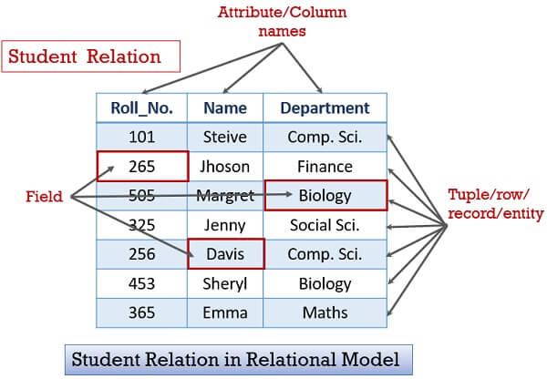

Slide 8
    ii. Entity-Relationship Model.
It uses a collection of basic objects, called entities, and relationships among these objects.
An entity is a “thing” or “object” in the real world that is distinguishable from other objects.
The entity-relationship model is widely used in database design.

Slide 9
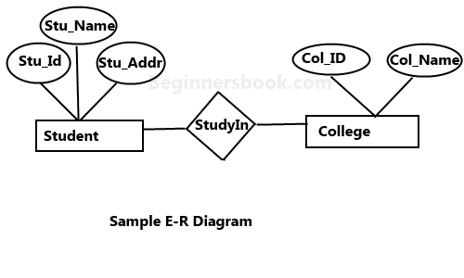

Slide 10
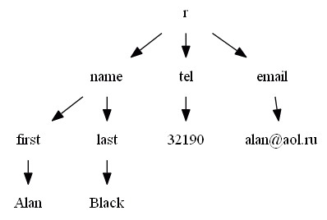
iii. Semi-structured Data Model.
It permits the specification of data where individual data items of the same type may have different sets of attributes.
Example: JSON and Extensible Markup Language (XML)

Slide 11
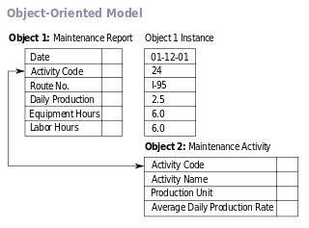
iv. Object-Based Data Model.
Objects are well integrated into relational databases.Standards exist to store objects in relational tables.
Database systems allow procedures to be stored in the database system and executed by the database system

Slide 12
1.3.2 Relational Data Model
Data are represented in the form of tables.
Each table has multiple columns, and each column has a unique name.
Each row of the table represents one piece of information.

Slide 13
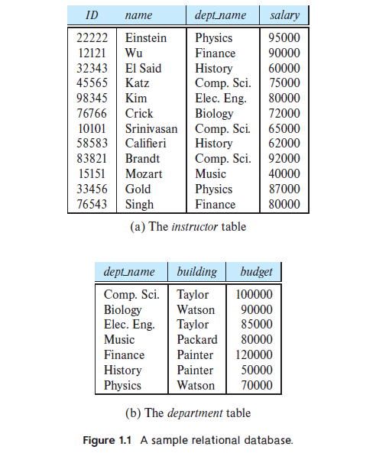

Slide 14
1.3.3 Data Abstraction
The need for efficiency has led database system developers to use complex data structures to represent data in the database.
There are several levels of data abstraction:
Physical level. The lowest level of abstraction describes how the data are actually stored. The physical level describes complex low-level data structures in detail.

Slide 15
Logical level. The next-higher level of abstraction describes what data are stored in the database, and what relationships exist among those data.
The simple structures at the logical level may involve complex physical-level structures, the user of the logical level does not need to be aware of this complexity. This is referred to as physical data independence.

Slide 16
View level. The highest level of abstraction describes only part of the entire database.
Many users of the database system do not need all this information; instead, they need to access only a part of the database.
The view level of abstraction exists to simplify their interaction with the system.
The system may provide many views for the same database.

Slide 17
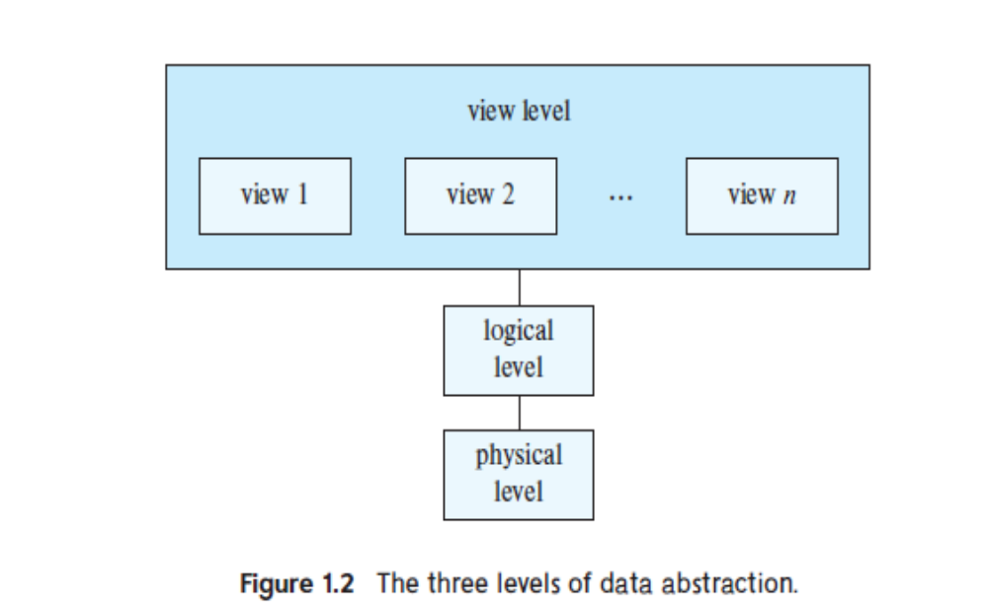

Slide 18
1.3.4 Instances and Schemas
The collection of information stored in the database at a particular moment is called an instance of the database.
The overall design of the database is called the database schema.
A database schema corresponds to the variable declarations in a program.

Slide 19
Each variable has a particular value at a given instant.
The values of the variables in a program at a point in time correspond to an instance of a database schema.
The physical schema describes the database design at the physical level, while the logical schema describes the database design at the logical level.
A database may also have several schemas at the view level, sometimes called sub schemas, that describe different views of the database.

